Slide 1
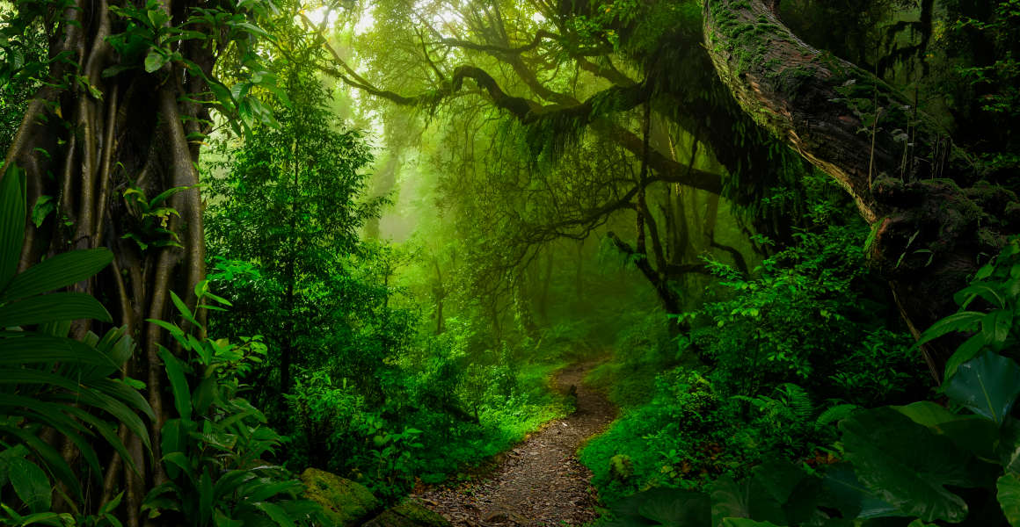
2050 VISION ON BIODIVERSITY
GROUP 22

Slide 2
OUTLINE
Introduction to 2050 vision on Biodiversity
Essence of a long-term vision for biodiversity.
Main goals of the 2050 vision on biodiversity
Strategies and Approaches to achieve the set goals
Benefits of the 2050 vision
Potential challenges
Conclusion

Slide 3
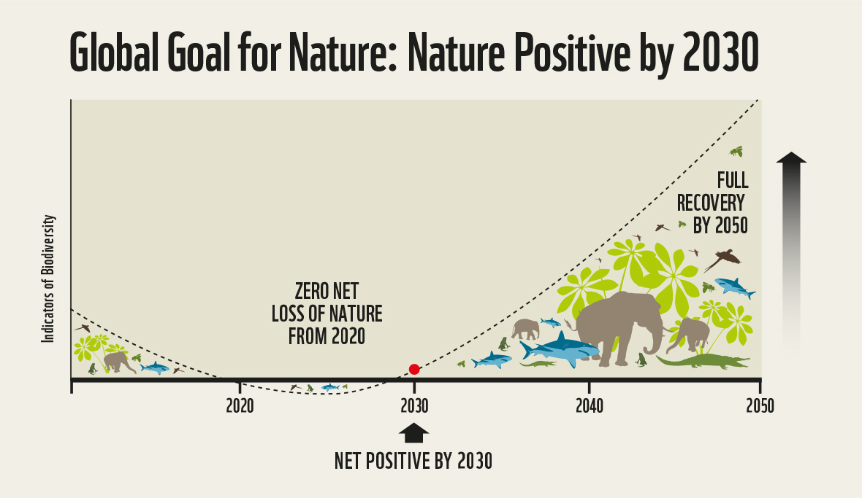
INTRODUCTION
The 2050 Vision on Biodiversity aims to safeguard and enhance the Earth’s Biodiversity for the well being of present and future generations
Fig 1.1

Slide 4
RATIONALE BEHIND THE 2050 VISION
Recognition of the urgent need to protect and restore biodiversity
Alignment with international commitments (e.g., Convention on Biological Diversity)
Acknowledgement of the interconnectedness between biodiversity and climate

Slide 5
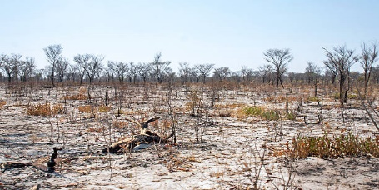
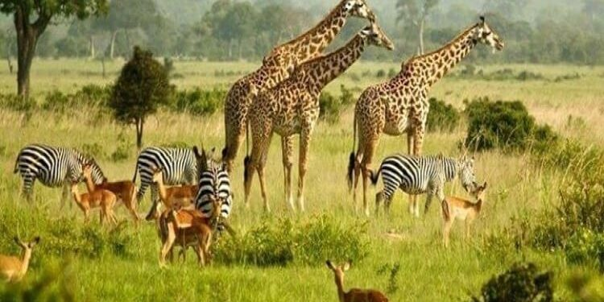
Fig 1.2
Fig 1.3

Slide 6
GOALS OF VISION 2050
Conservation and restoration of ecosystems
Strategies for protecting and managing natural habitats
Implementation of ecosystem restoration initiatives
2. Sustainable use of biodiversity
Promoting responsible practices in agriculture, forestry and fisheries
Encouraging sustainable consumption and production patterns

Slide 7
GOALS OF VISION 2050
3. Fair and equitable sharing of benefits.
A fair share of natural resources leaves no incentive for overexploitation.
4. Integration of biodiversity into decision-making
Incorporating biodiversity considerations into policies and planning processes.
Strengthening partnerships and collaborations

Slide 8
STRATEGIES AND APPROACHES
Strengthening protected areas and expanding their coverage
Sustainable land and fisheries management
Habitat restoration
Facilitating international cooperation and partnerships
Enhancing education and awareness about biodiversity
Climate change mitigation

Slide 9
CHALLENGES
Financial constraints.
Societal values – different perspectives on the importance of conserving biodiversity.
Addressing socio-economic factors and engaging local communities
Harnessing technological innovations for biodiversity conservation

Slide 10
BENEFITS OF VISION 2050
Healthy ecosystems
Species preservation
Socio-economic benefits- Preserving natural habitats and species promote ecotourism which generates revenue and creates opportunities for employment

Slide 11
CONCLUSION
The 2050 vision for biodiversity holds tremendous promise for the future of our planet. By implementing sustainable practices, conserving habitats and promoting environmental stewardship, we can ensure the flourishing of diverse ecosystems and the preservation of countless species.
With concerted efforts, we can leave a lasting legacy of a thriving and biodiverse world for generations to come. Let us embark on this transformative journey together because your planet needs you.

Slide 12


Slide 13


Slide 14
REFERENCES
Unit, B. (2023) 2050 vision and 2030 mission, Convention on Biological Diversity. https://www.cbd.int/gbf/vision/
https://www.cbd.int/gbf/goals/
SDG knowledge hub: https://sdg.iisd.org/news/first-draft-of-global-biodiversity-framework-identifies-four-goals-for-2050/
Towards the vision 2050 on biodiversity: Living in harmony with nature. https://www.unep.org/news-and-stories/story/towards-vision-2050-biodiversity-living-harmony-nature
Trondheim conference https://trondheimconference.org/program-development

